Slide 1



NLMC25 Virtual Conference
Saturday 4th October 2025
9.50 - 17.40

Slide 2
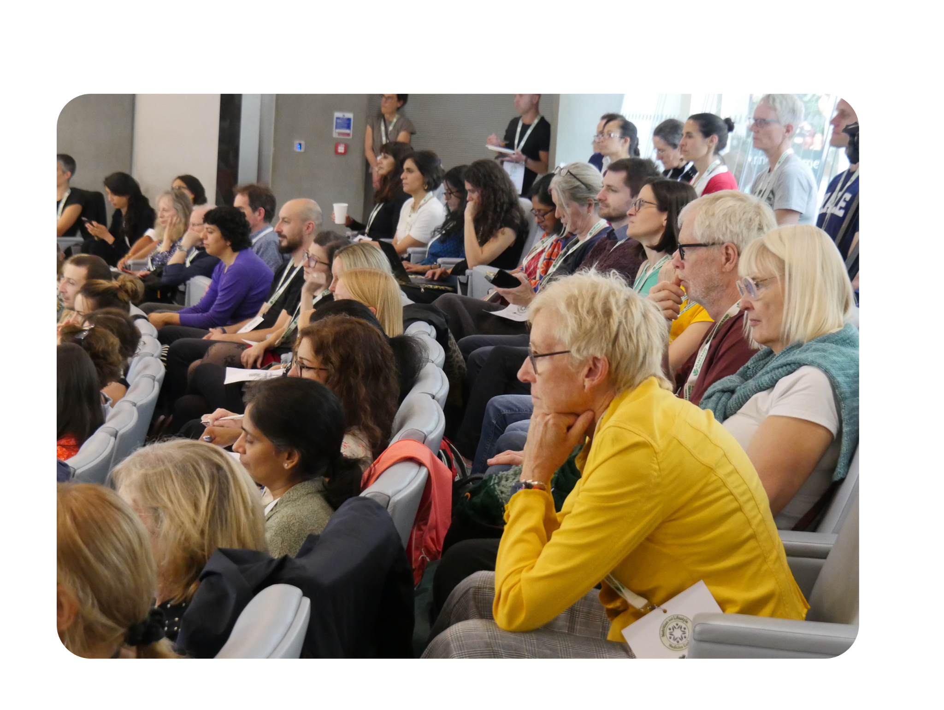
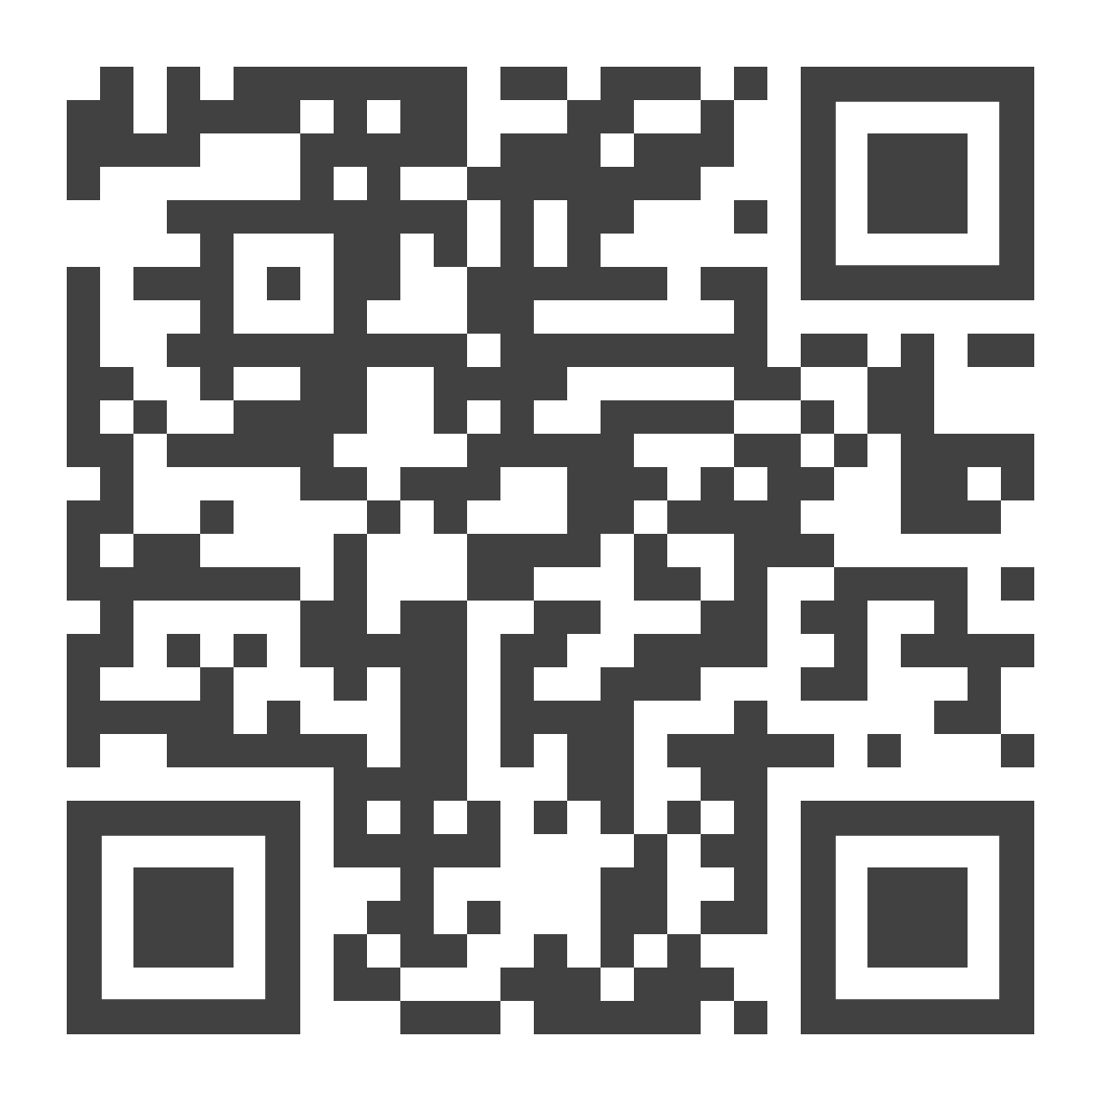
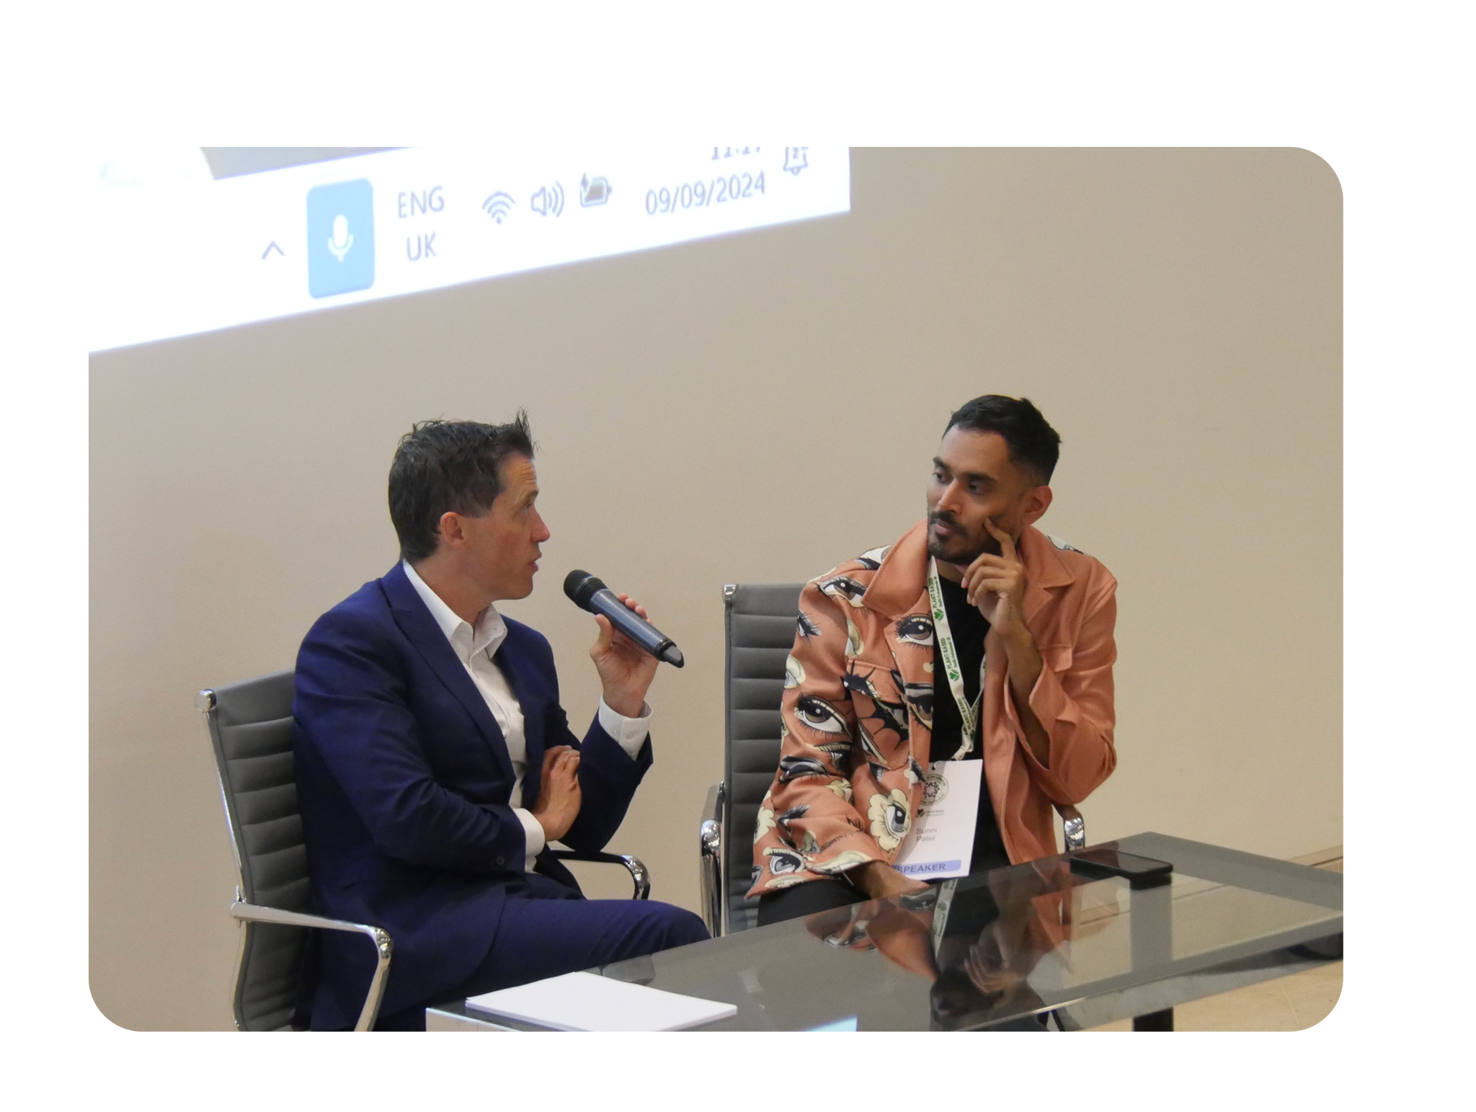
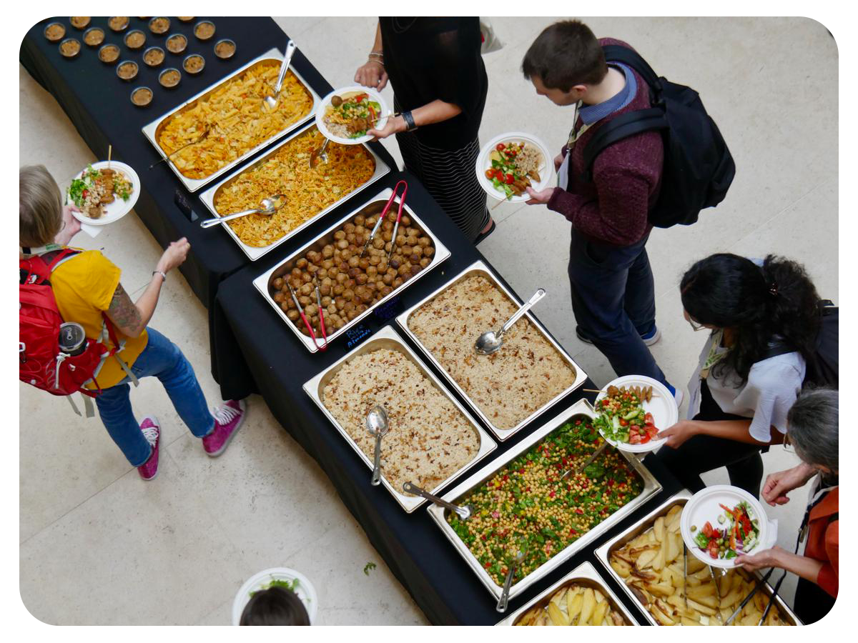
NLMC25 LIVE
Join us for our best-ever 2-day in person conference in West London packed full of inspiring speakers, experts in the field of nutrition and lifestyle medicine.
6th and 7th November
Notes:
Please add the dates November 6/7

Slide 3

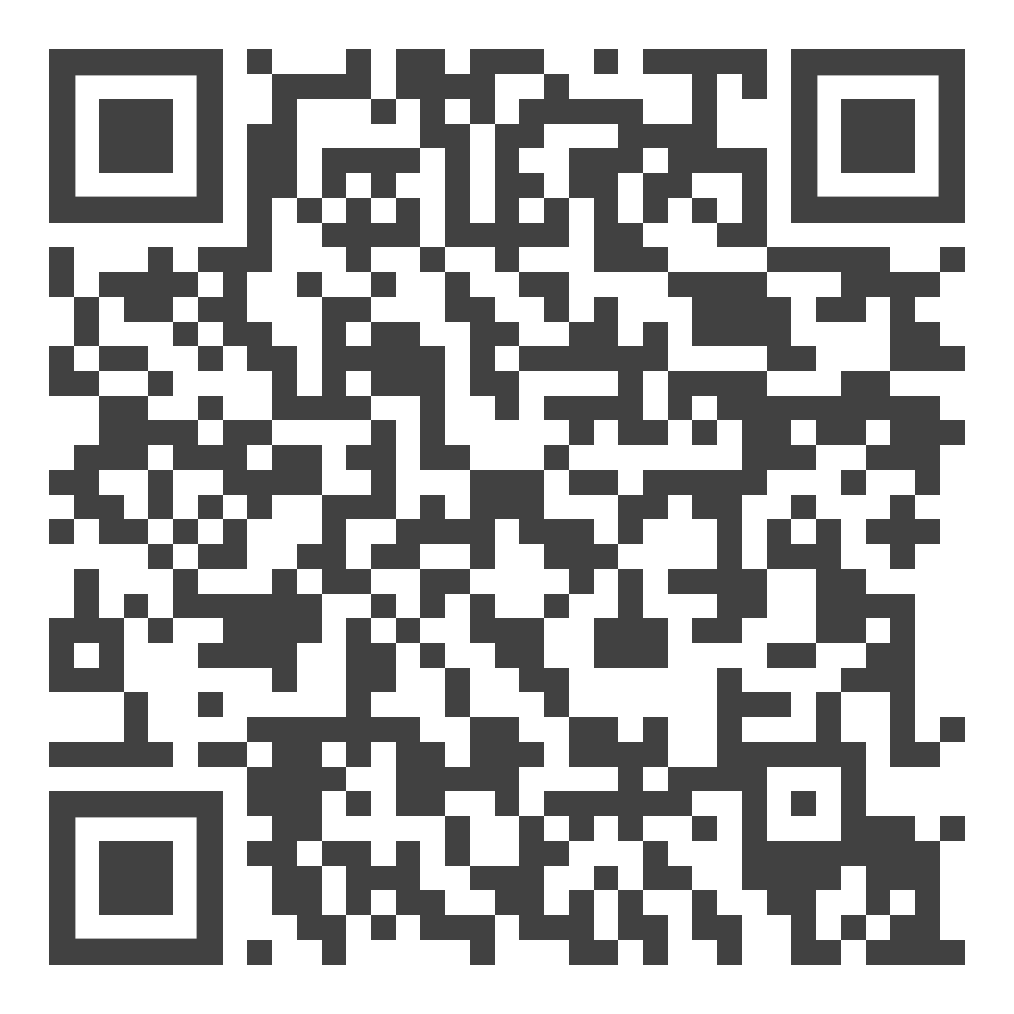
In A Nutshell
Podcast
Your weekly dose of plant-based nutrition and lifestyle medicine education
Notes:
Your weekly dose of plant-based nutrition and lifestyle medicine education

Slide 4

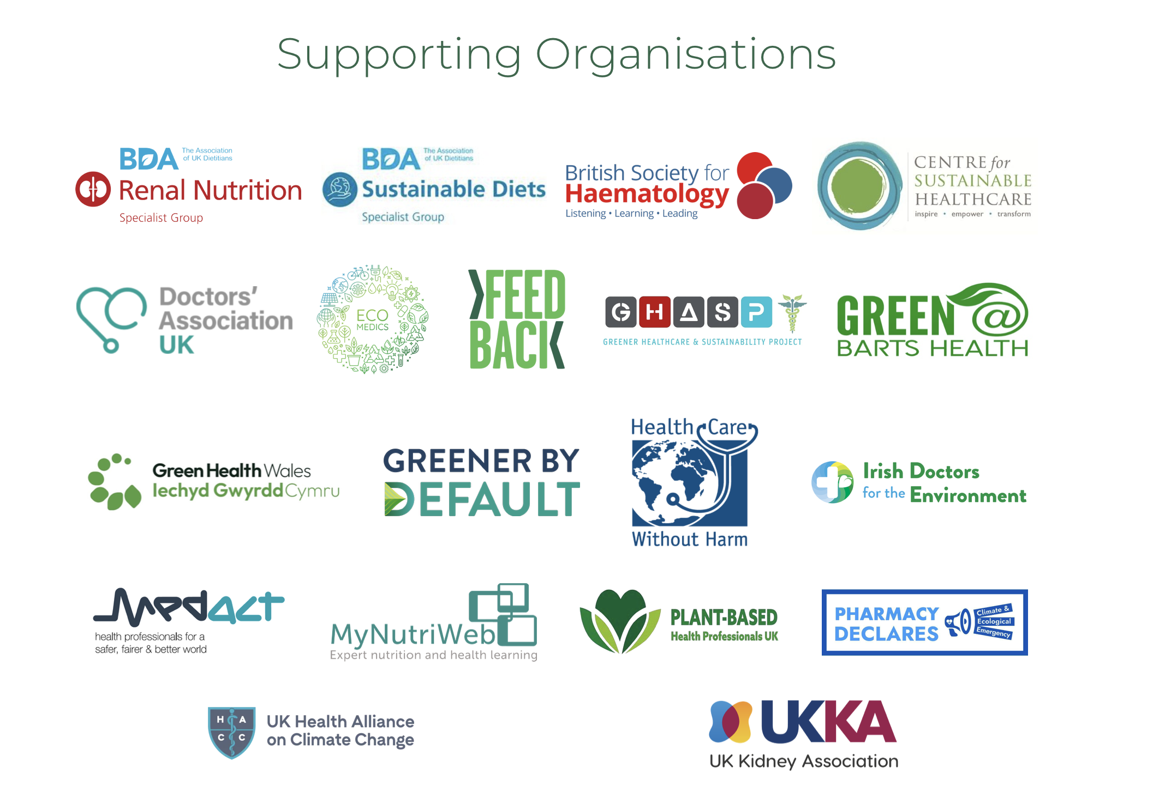
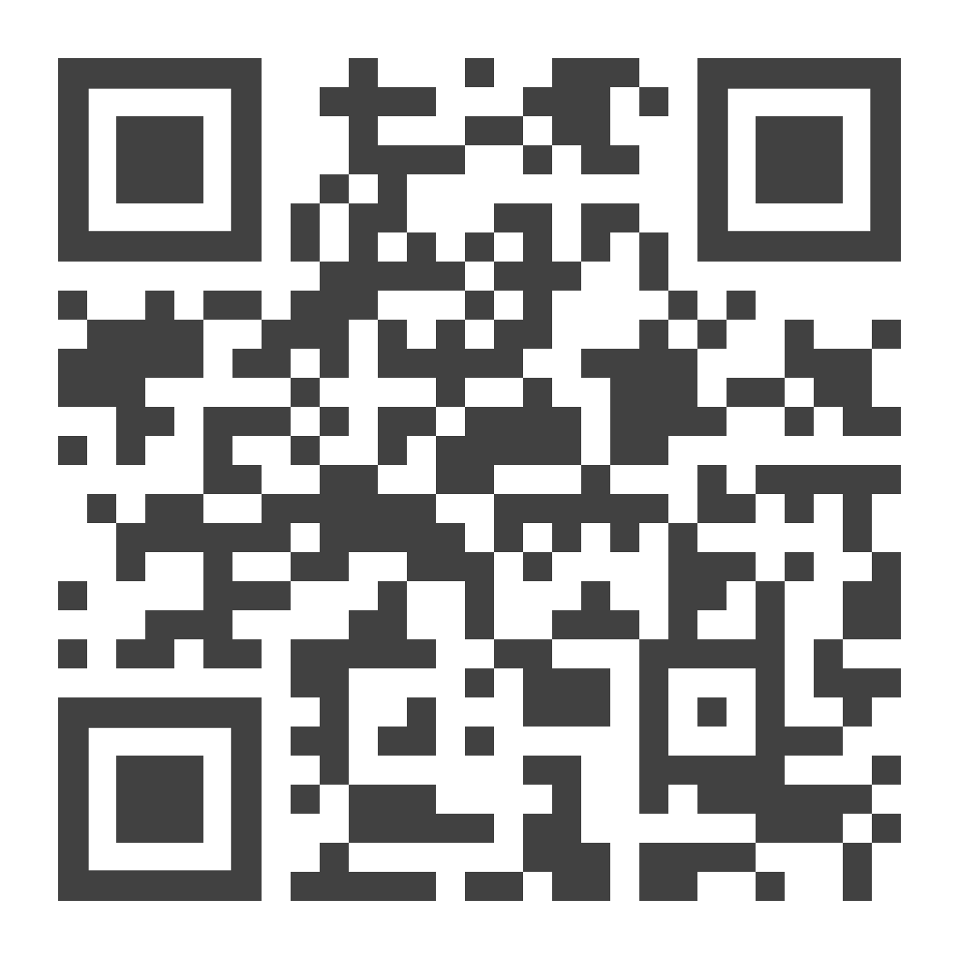
Plants First Healthcare
Supporting the NHS to prioritise plant-based meals on patient and staff menus.
Supported by 24 healthcare organisations.
Notes:
Supporting the NHS to prioritise plant-based meals on patient and staff menus.
Supported by 24 healthcare organisations
Rather than the snap shot of the video please add the logo

Slide 5


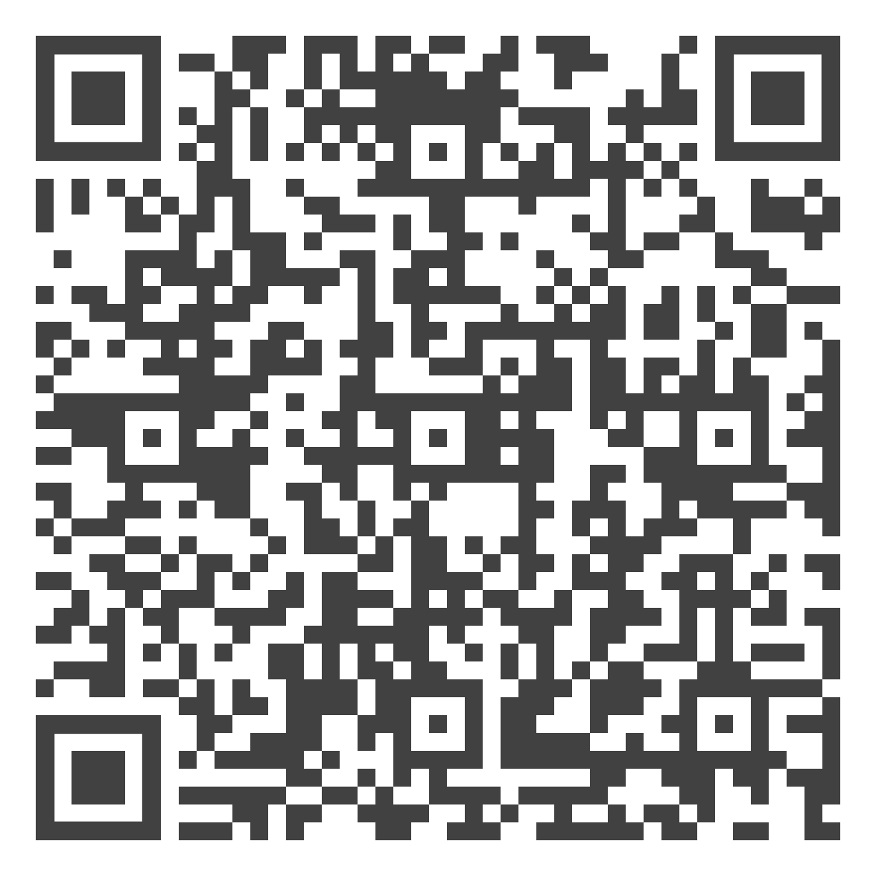
Download the
Food in Healthcare Report

Slide 6
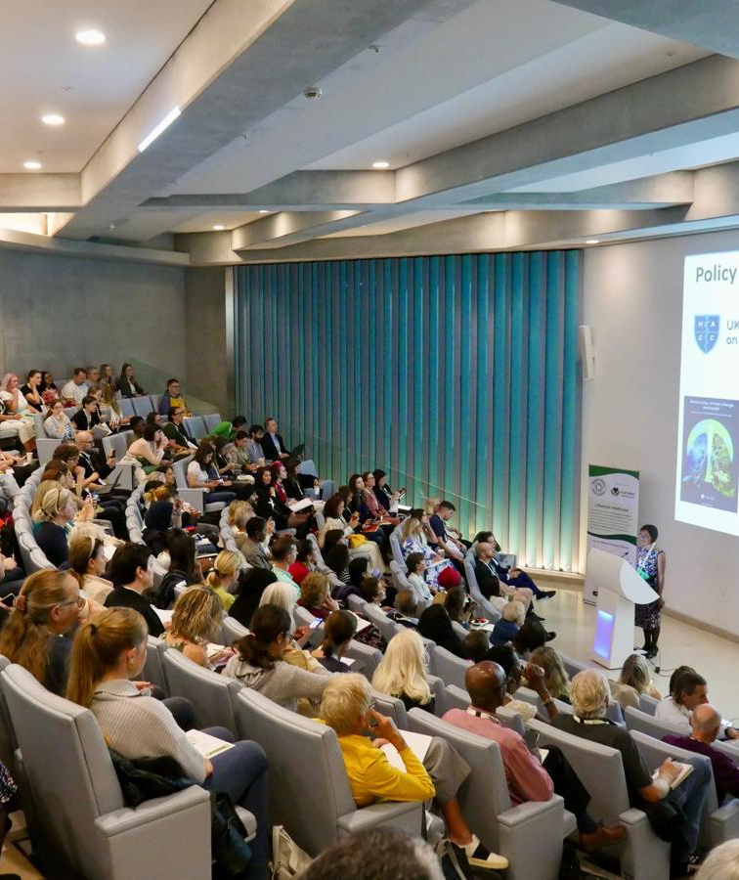
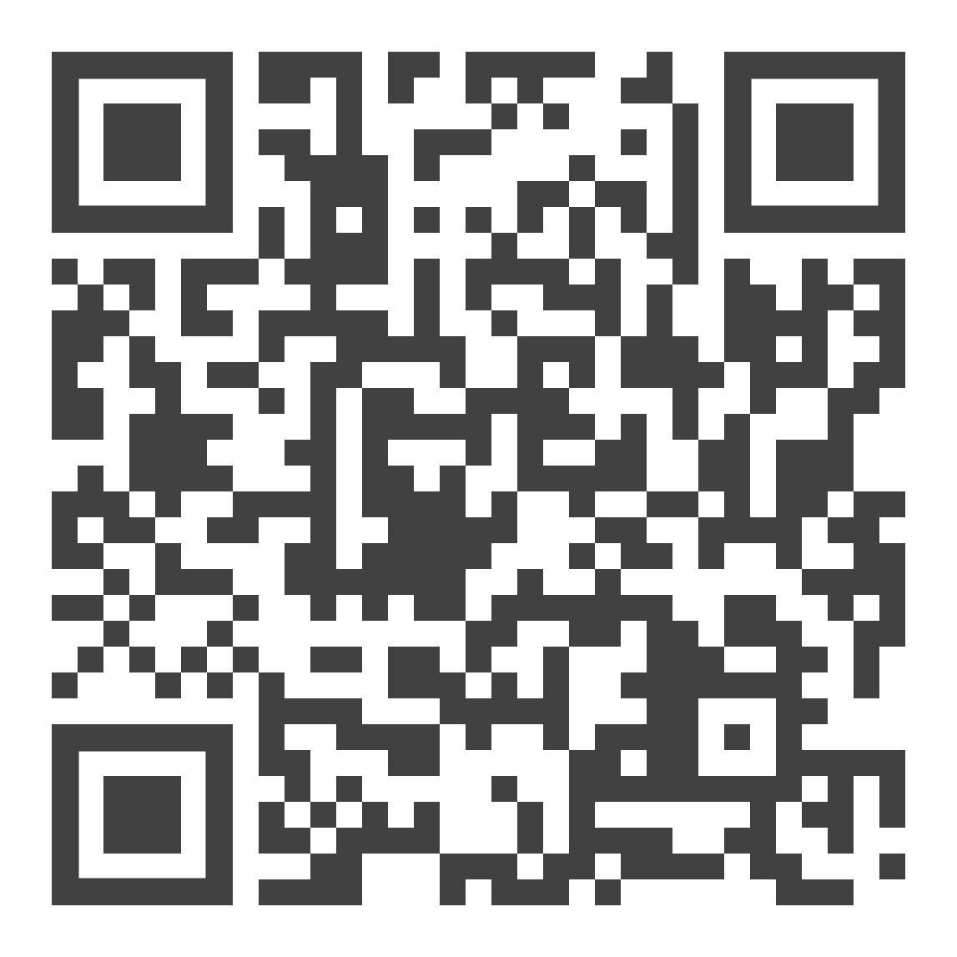
Become a member
Be part of our thriving community.

Slide 7
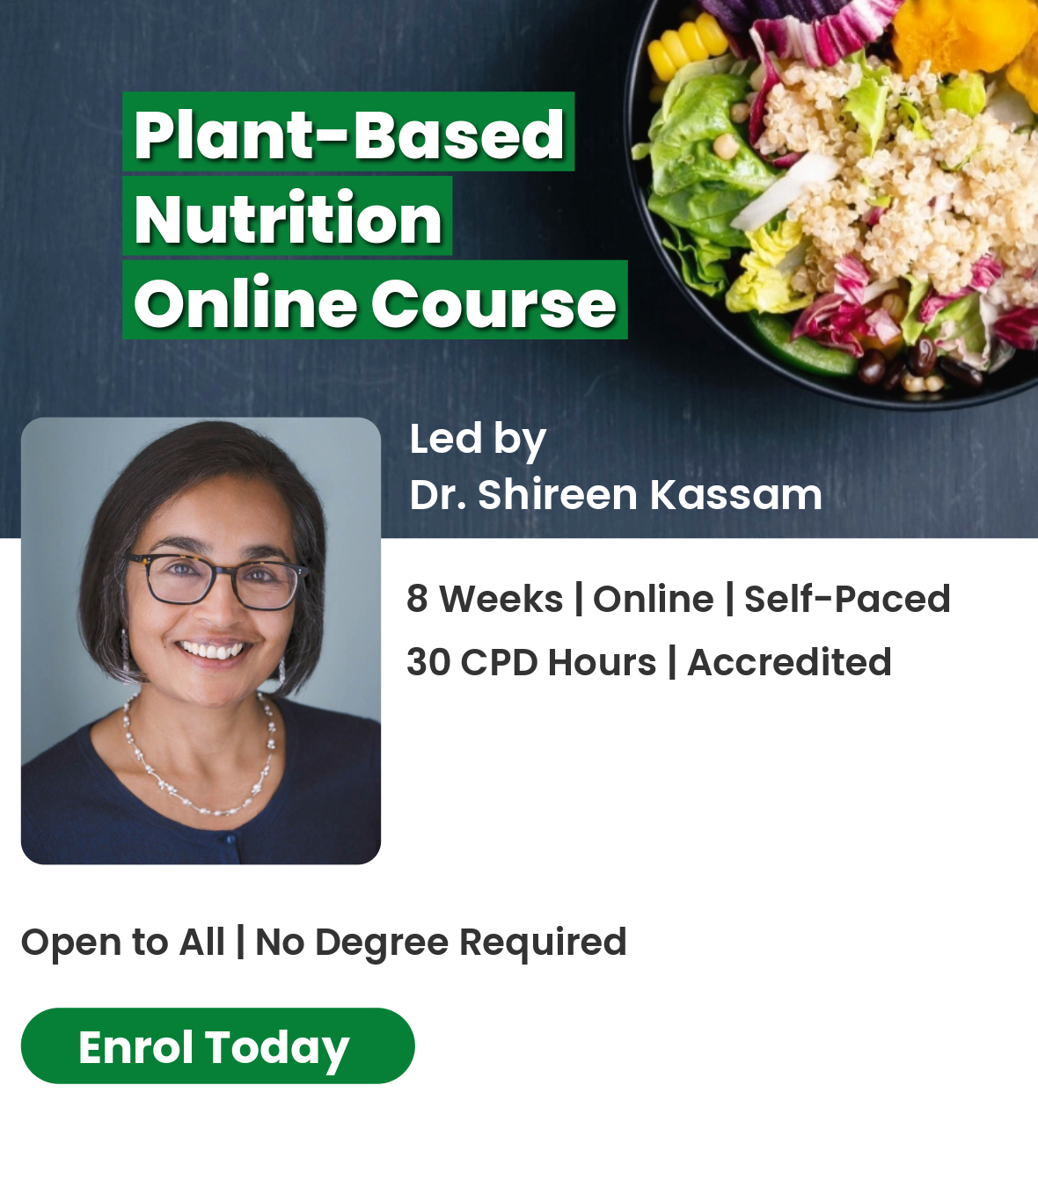
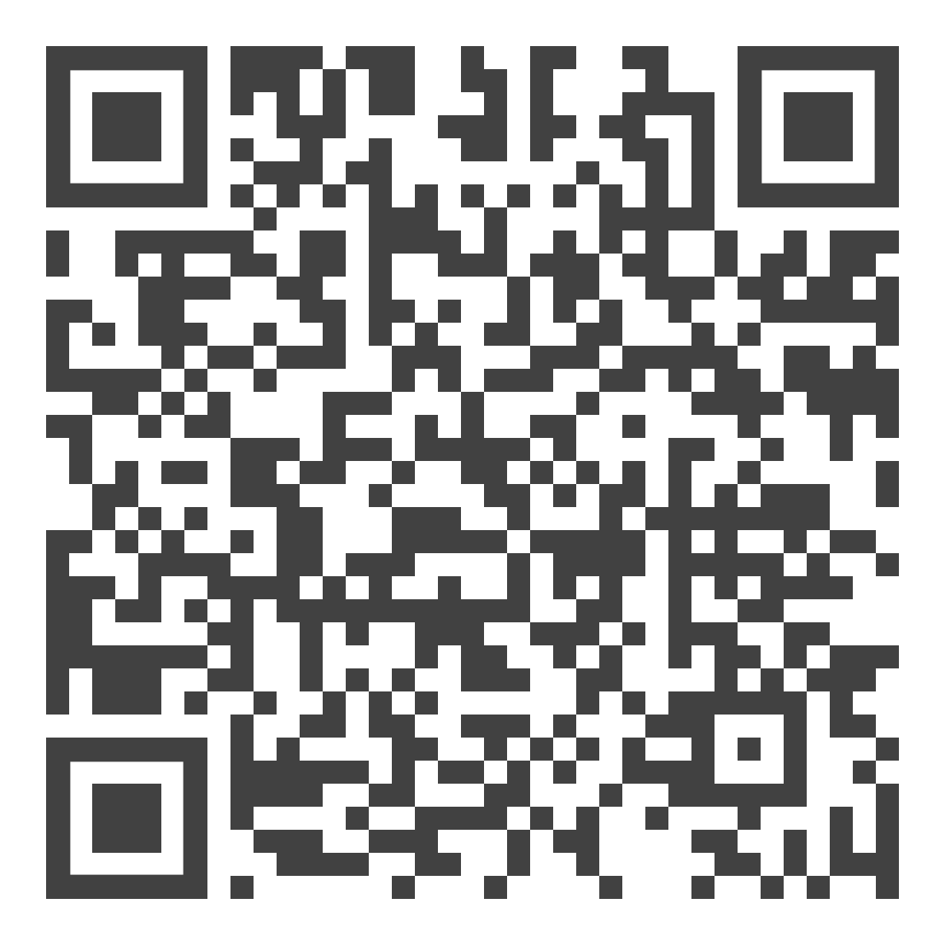

Plant-Based Nutrition
Online Course
University of Winchester
Notes:
Could you add one of your graphics you made for social media rather than the current picture as it will give people more information

Slide 8
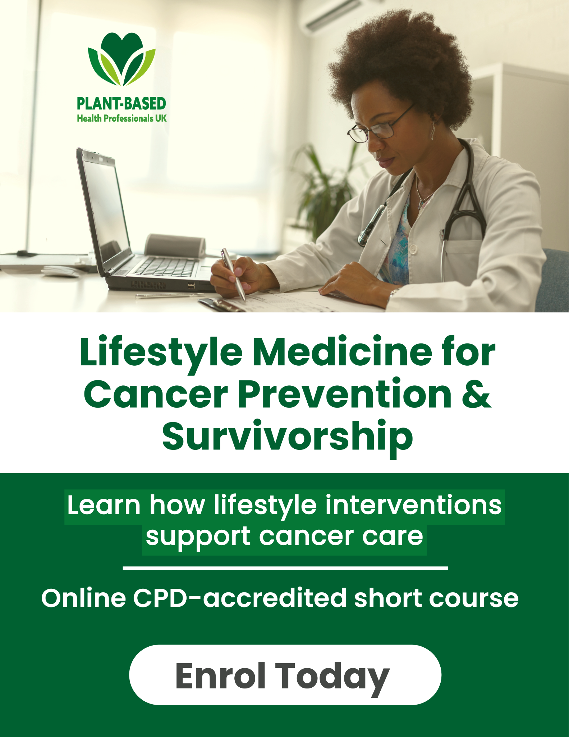
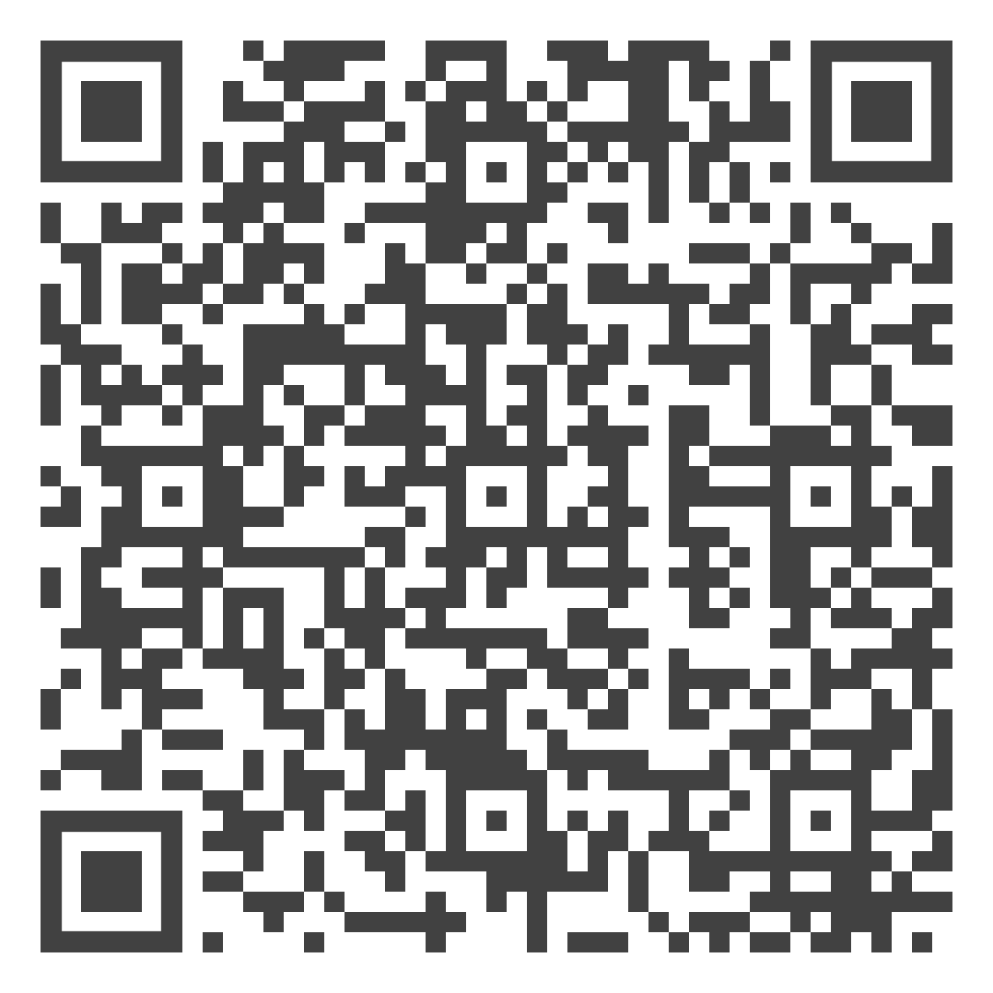
Lifestyle Medicine for Cancer Prevention and Survivorship
Online Course
University of Winchester
Notes:
Same with this please

Slide 9

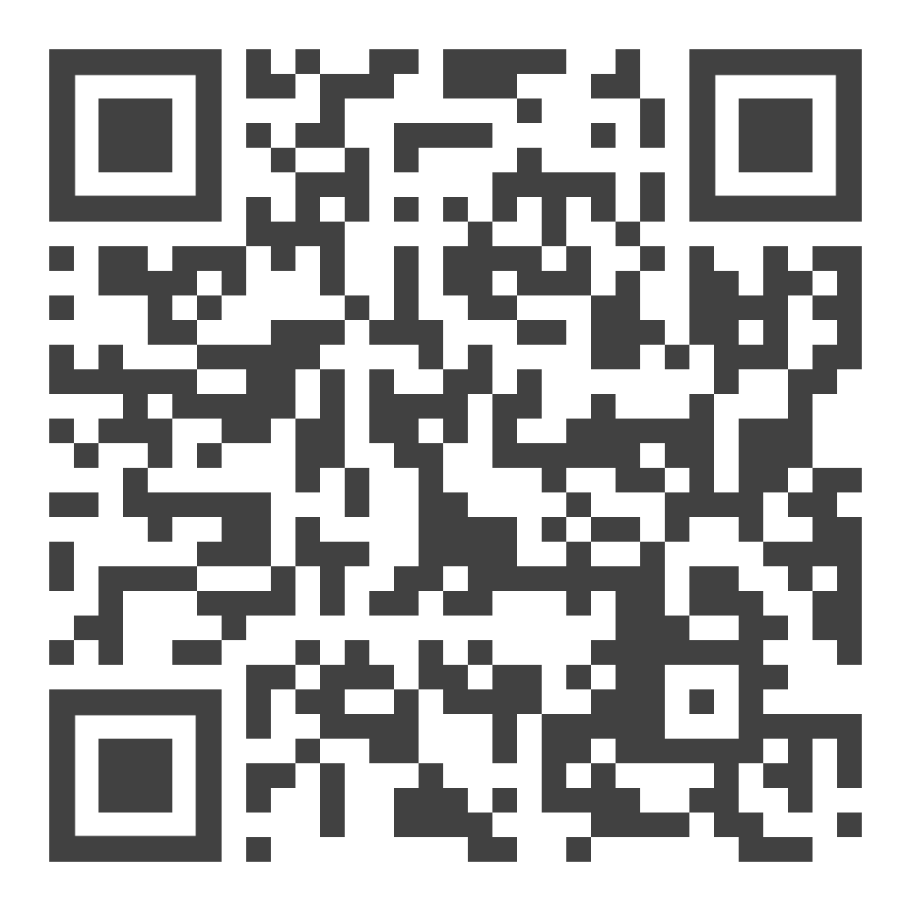
Join the FREE
21 Day Plant-Based Health Challenge

Slide 10

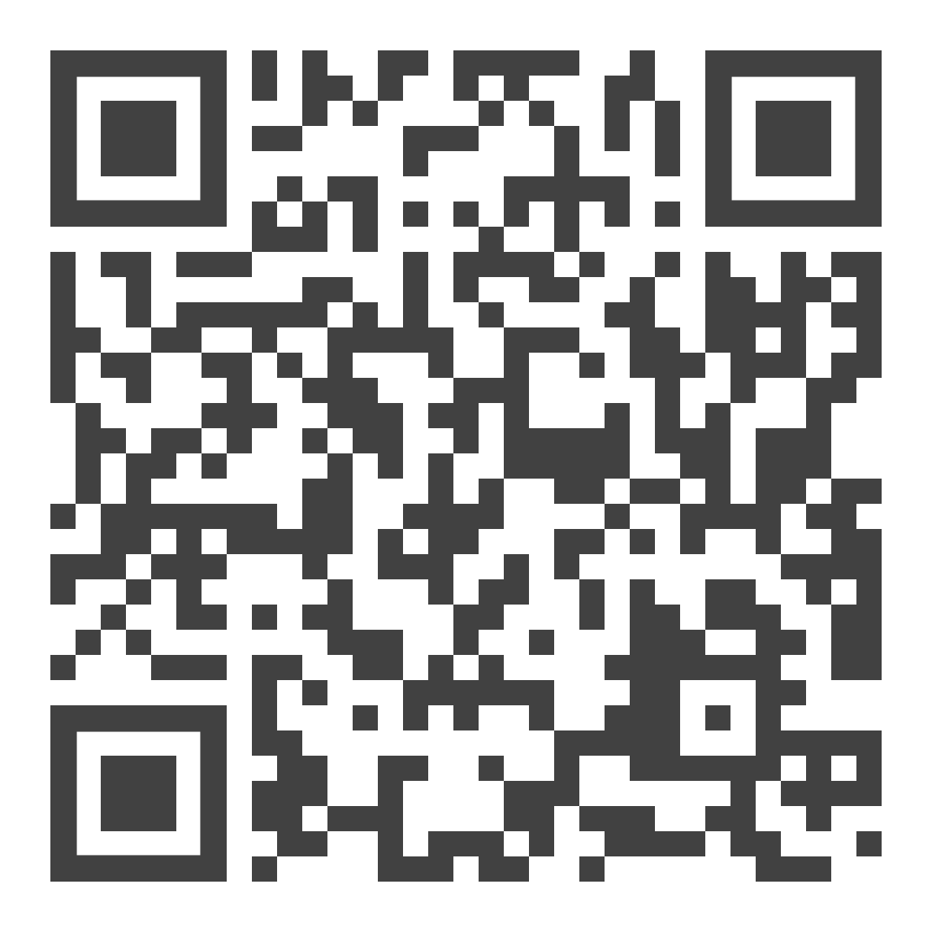
IBLM Certification
Get certified in Lifestyle Medicine

Slide 11
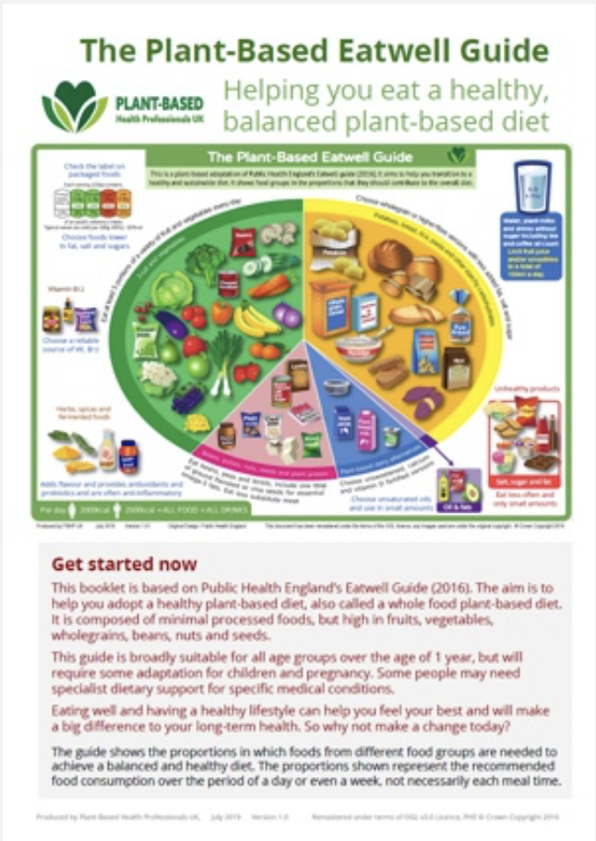

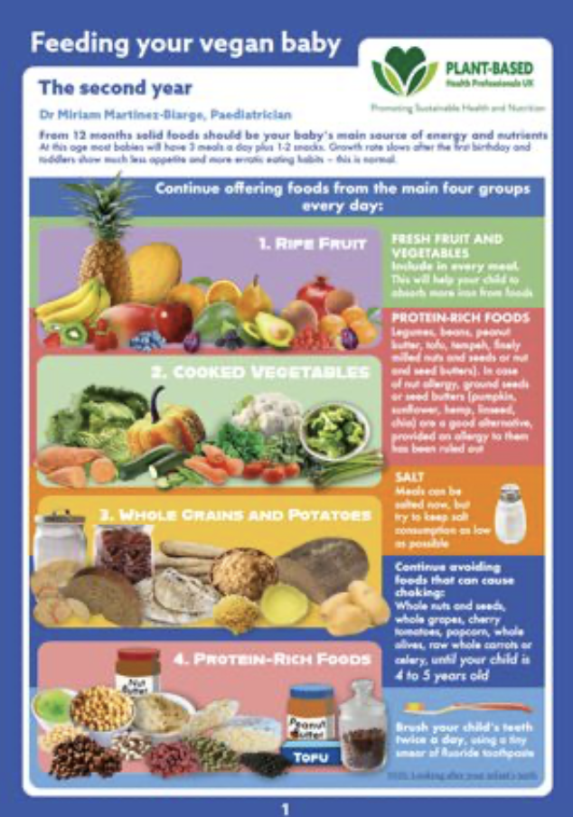
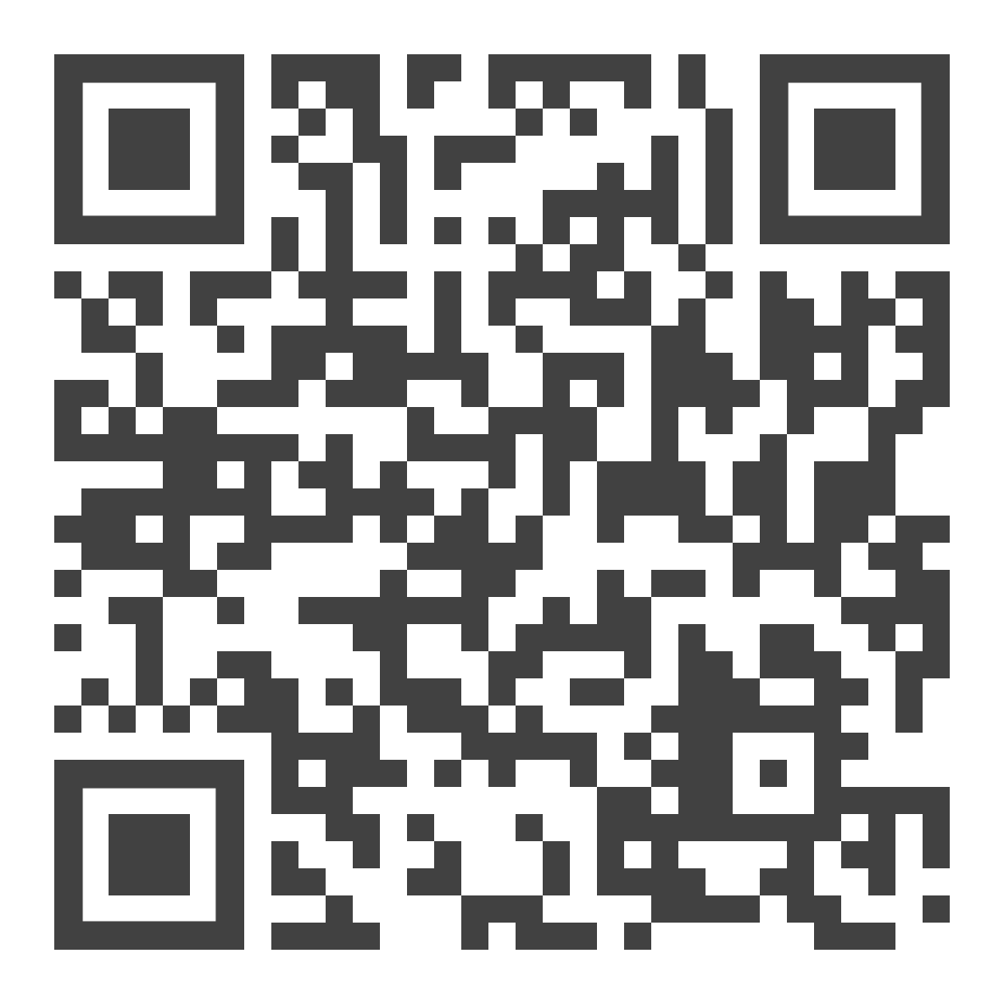
Download FREE Factsheets

Slide 12

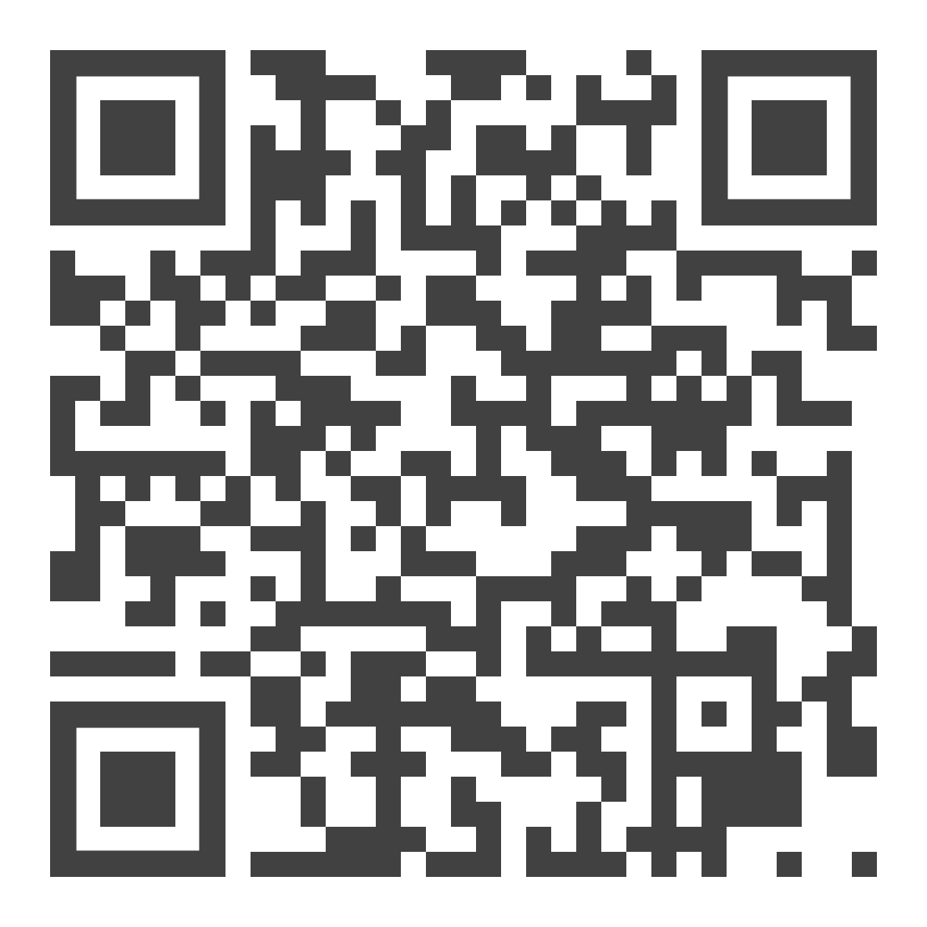
Live webinars
Free to join for everyone.
CPD-accredited

Slide 13
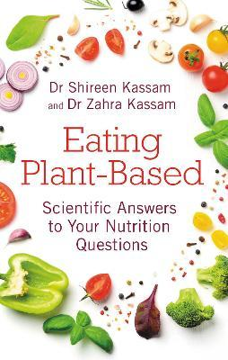
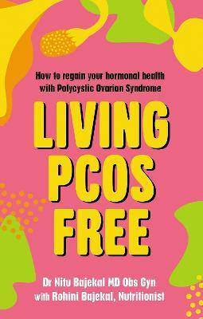
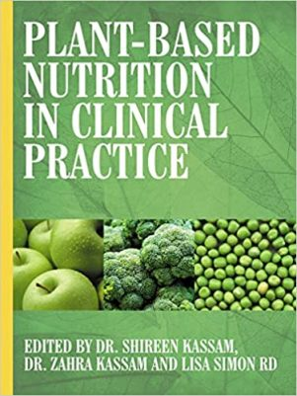
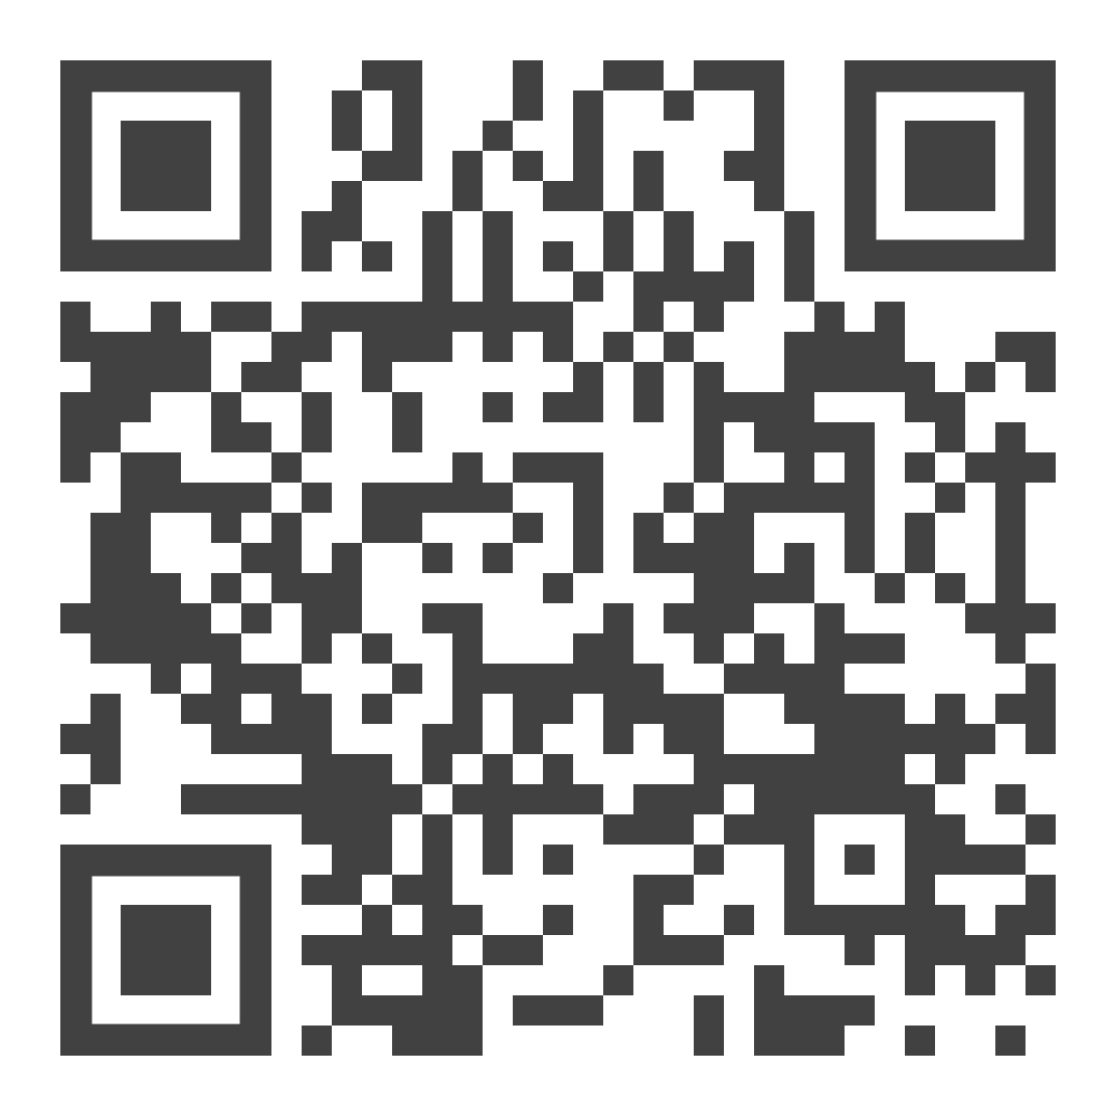

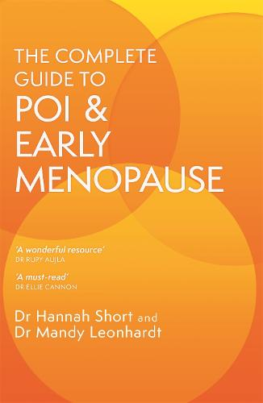

Explore Our Recommended Books
Notes:
Please replace the vegan child book with sarah bentley news book - top of this page https://plantbasedhealthprofessionals.com/books

